Slide 1
Instance | Operational setting0 | Operational setting1 | ……… | Sensor measurement13 | Time | Label
1 | 0.238 | 0.297 |  | 0.616 | 184 | 1
2 | 1 | 0.998 |  | 0.003 | 271 | 0
3 | 0 | 0.001 | ……… | 1 | 249 | 0
4 | 0.833 | 0.998 |  | 0.146 | 227 | 0
5 | 1 | 0.998 |  | 0.003 | 193 | 1
6 | 1 | 0.999 |  | 0.003 | 209 | 0

Slide 2
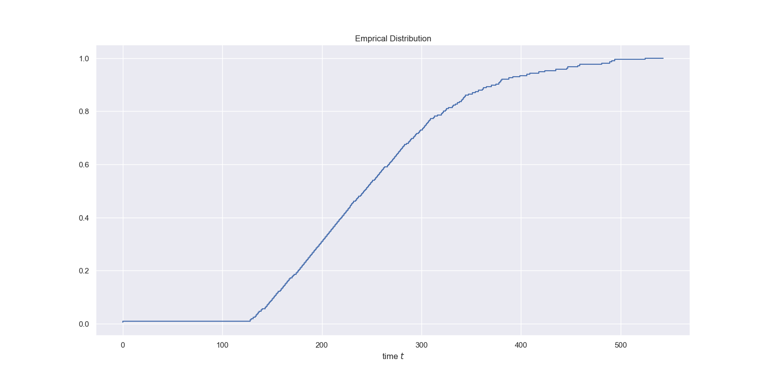

Slide 3
X
Shared
Sub-network
……
Fully-Connected Layer
Fully-Connected Layer
Cause-Specific
Sub-network
z=(f_{s}(x),x)
+
Event 1
Event K
……
……
FC Layer
FC Layer
……
FC Layer
FC Layer
Softmax Layer
y_{1,1} y_{1,2}…… y_{1,Tmax}
……
y_{K,1} y_{K,2}…… y_{K,Tmax}

Slide 4
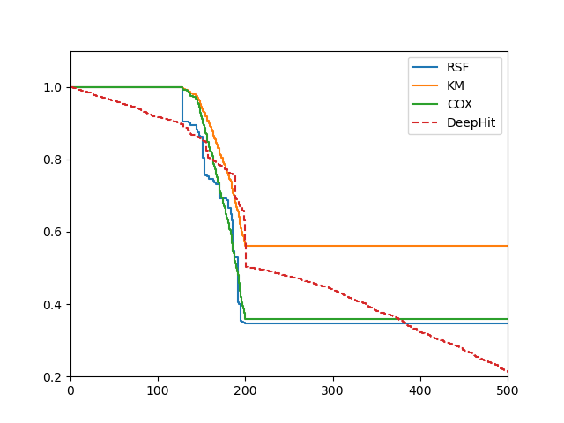
NASA: Random 50 times & fine-tune
Probability
time

Slide 5
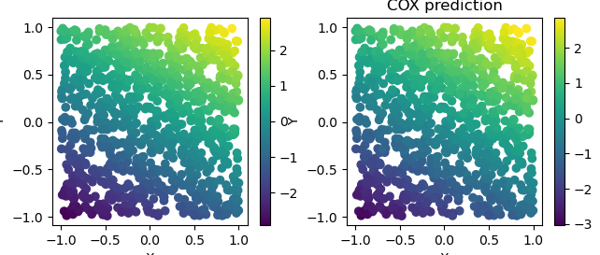
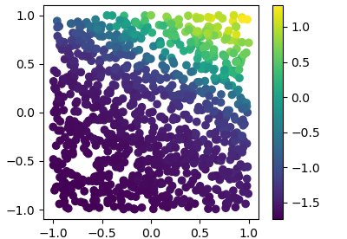
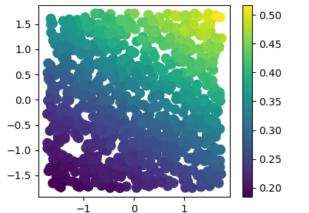






(a)true
(b)cox
$$x_{1}$$
$$x_{1}$$
$$x_{0}$$
$$x_{0}$$
c)DeepSurv
d)DeepHit
$$x_{1}$$
$$x_{1}$$
$$x_{0}$$
$$x_{0}$$

Slide 6
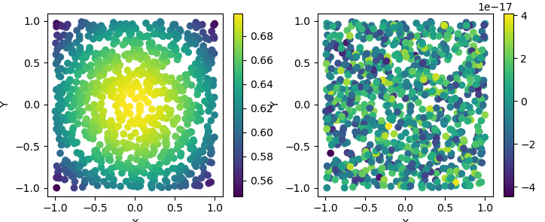
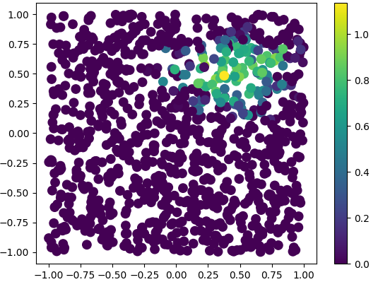
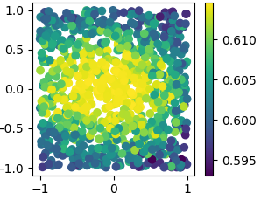

(a)true
(b)cox
$$x_{1}$$
$$x_{1}$$
$$x_{1}$$
$$x_{0}$$
$$x_{0}$$
c)DeepSurv
d)DeepHit
$$x_{1}$$
$$x_{1}$$
$$x_{1}$$
$$x_{0}$$
$$x_{0}$$

Slide 7
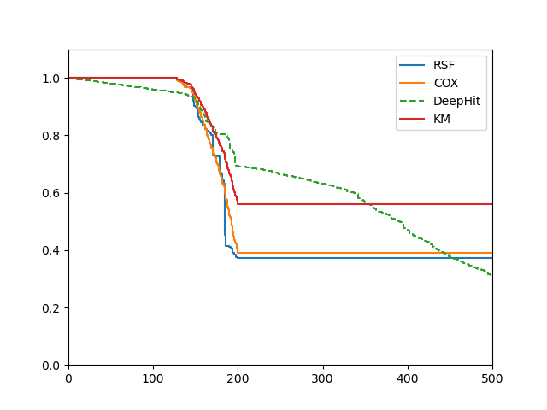
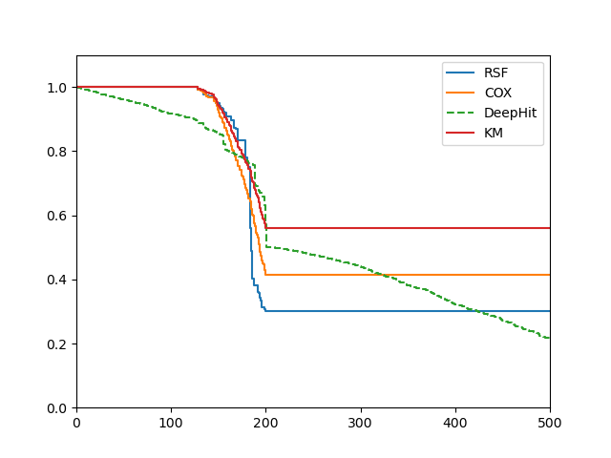
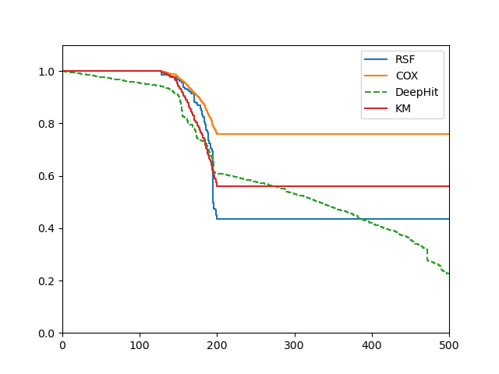
a)Average
b)Instance 1
c)Instance 2

